Slide 1
Design Pattern
Design patterns represent the best practices used by experienced object-oriented software developers.
Design patterns are solutions to general problems that software developers faced during software development.
These solutions were obtained by trial and error by numerous software developers over quite a substantial period of time.

Slide 2
What is Gang of Four (GOF)?
In 1994, four authors Erich Gamma, Richard Helm, Ralph Johnson and John Vlissides published a book titled Design Patterns - Elements of Reusable Object-Oriented Software which initiated the concept of Design Pattern in Software development.
These authors are collectively known as Gang of Four (GOF). According to these authors design patterns are primarily based on the following principles of object oriented design.
Program to an interface not an implementation
Favor object composition over inheritance

Slide 3
Usage of Design Pattern
Design Patterns have two main usages in software development.
Common platform for developers
Design patterns provide a standard terminology and are specific to particular scenario. For example, a singleton design pattern signifies use of single object so all developers familiar with single design pattern will make use of single object and they can tell each other that program is following a singleton pattern.
Best Practices
Design patterns have been evolved over a long period of time and they provide best solutions to certain problems faced during software development. Learning these patterns helps inexperienced developers to learn software design in an easy and faster way.

Slide 4
Types of Design Patterns
As per the design pattern reference book Design Patterns - Elements of Reusable Object-Oriented Software, there are 23 design patterns which can be classified in three categories:
Creational
Structural
Behavioral

Slide 5
Creational
Talks about object creations.
To make design more readable and less complexity.
Talks about efficiently object creation.
Example: Singleton Pattern

Slide 6
Structural
Talks about how classes and objects can be composed.
Parent-child relationship like inheritance used for structuring more than one classes.
Deals with simplicity in identifying relationships.
Example: Adapter Pattern

Slide 7
Behavioral
Deals with interactions and responsibility of objects.
Used for identifying and setting up common communication patterns among objects.
Example: Observer Pattern

Slide 8
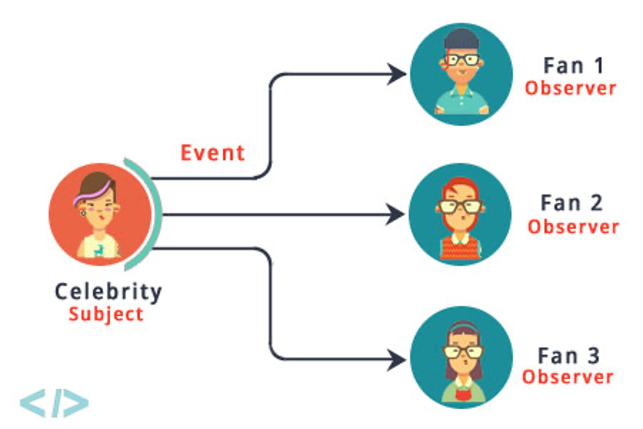
Observer Pattern
Intent: Define a one-to-many dependency between objects so that when one object change state, all its dependents are notified and updated automatically.

Slide 9
Colab File for Examples
Design Patterns Example.ipynb

Slide 10
Student-Teacher Example
Class Teacher:
def __init__(self, name):
self.students=[]
self.name=name
def attach_student(self, student):
self.students.append(student)
print(f”{student.name} has been attached to {self.name}”)
Class Student:
def__init__(self,name):
self.teachers=[]
self.name=name
def add_teachers(self,teacher):
self.teachers.append(teacher)
teacher.attach_student(self)
We also need remove methods in both classes.
# driver code
teacher_fzn = Teacher(“FZN”)
student_ryan = Student(“Ryan”)
student_ryan.add_teacher(teacher_fzn)

Slide 11
Fan-Celebrity Example
# Subject (Celebrity)
class Celebrity:
def __init__(self):
self._fans = []
self._state = None
def attach(self, fan):
self._fans.append(fan)
def detach(self, fan):
if fan in self.__fans:
self._fans.remove(fan)
def notify(self):
for fan in self._fans:
fan.update(self)
def set_state(self, state):
self._state = state
self._notify()
def get_state(self):
return self._state
# Observer (Fan)
class Fan:
def __init__(self):
self._celebrities = []
def update(self, celebrity):
state = celebrity.get_state()
def add_celebrity(self, celebrity):
self._celebrities.append(celebrity)
celebrity.attach(self)
def remove_celebrity(self, celebrity):
self._celebrities.remove(celebrity)
celebrity.detach(self)
celebrity = Celebrity()
fan = Fan()
#fan starts following…
fan.add_celebrity(celebrity)
#celeb changes status and #notification is received by fan
celebrity.set_state('New state')
#fan can stop following…
fan.remove_celebrity(celebrity)

Slide 12
Observer Pattern in Java
public class Celebrity{
private List<Fan> fans = new ArrayList<Fan>();
private int state;
void attach(Fan f){
fans.add(f);
}
void remove(Fan f){
fans.remove(f);
}
void notify(){
foreach( Fan f: fans)
f.update(this);
}
void setState(int newState){
state = newState;
notify();
}
int getState(){
return state;
}
}
Celebrity class may look like this. Now add the Fan class

Slide 13
Observer Pattern in Java
public class Celebrity{
private List<Fan> fans=new ArrayList<Fan>();
private int state;
void attach(Fan f){
fans.add(f);
}
void remove(Fan f){
fans.remove(f);
}
void notify(){
foreach( Fan f: fans)
f.update(this);
}
void setState(int newState){
state = newState;
notify();
}
int getState(){
return state;
}
}
public class Fan{
private List<Celebrity> celebrities=new ArrayList<Celebrity>();
void update(Celebrity c){
c.getState();
}
void addCelebrity(Celebrity c){
celebrities.add(c);
c.attach(this);
}
void removeCelebrity(Celebrity c){
celebrities.remove(c);
c.remove(this);
}
}
From main method –
Fan f1 = new Fan();
Fan f2 = new Fan();
Celebrity c1 = new Celebrity();
Celebrity c2 = new Celebrity();
f1.addCelebrity(c1);
f1.addCelebrity(c2);
f2.addCelebrity(c1);
c1.setState(5); //new State
c2.setState(2); //newState

Slide 14
Participants
Subject: knows its observers. Any number of Observer objects may observe a subject. It sends a notification to its observers when its state changes. (ex: Celebrity)
Observer: defines an updating interface for objects that should be notified changes in a subject. (ex: Fans)
ConcreteSubject: (ex: FilmCelebrity, FashionCelebrity)
ConcreteObserver (ex: FilmFan, FashionFan)

Slide 15
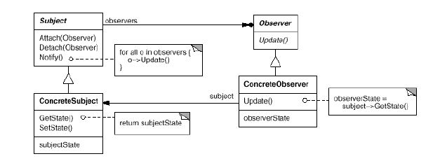
Structure

Slide 16
Advanced Observer with Concrete subjects and observers
Public FilmCelebrity extends Celebrity{
private int state;
void setState(int newState){
state = newState;
notify();
}
int getState(){
return state;
}
}

Slide 17
Advanced Observer with Concrete subjects and observers
public class FilmFan extends Fan{
private List<FilmCelebrity> filmCelebrities= new ArrayList<FilmCelebrity>();
void update(FilmCelebrity fc){
if(filmCelebrities.contain(fc){
fc.getState();
}
}
void addCelebrity(FilmCelebrity fc){
celebrities.add(fc);
fc.attach(this);
}
void removeCelebrity(FilmCelebrity fc){
celebrities.remove(fc);
fc.remove(this);
}
}
Public FilmCelebrity extends Celebrity{
private int state;
void setState(int newState){
state = newState;
notify();
}
int getState(){
return state;
}
}

Slide 18

Singleton Pattern
public class HelpDesk{
public void getService(){
// Implement the service
}
}
public class Student{
HelpDesk hd = new HelpDesk();
hd.getService();
}
public class Teacher{
HelpDesk hd = new HelpDesk();
hd.getService();
}
In reality one Single HelpDesk is serving all. No need for multiple objects.

Slide 19
BASIC
class MyClass:
counter = 0
def __init__(self):
type(self).counter += 1 # Accessing class variable via the instance
@classmethod
def instances_created(cls):
return cls.counter # Accessing class variable via cls

Slide 20
Singleton Pattern(EX-1)
class Singleton:
_instance = None
def __new__(cls):
if cls._instance is None:
print(' instance creating’)
cls._instance = super(Singleton, cls).__new__(cls)
return cls._instance
def get_service(self):
print("Service has been provided by the Singleton instance.")
# Usage
if __name__ == "__main__":
# Let's assume that multiple clients need the service
client1 = Singleton()
client2 = Singleton()
client3 = Singleton()
client1.get_service()
client2.get_service()
client3.get_service()
print(client1 is client2 is client3)
The __init__ method is called after the object is created by the __new__ method, and it initializes the object attributes with the values passed as arguments.
__new__ is responsible for creating and returning a new instance, while __init__ is responsible for initializing the attributes of the newly created object.
OUTPUT=>
instance creating
Service has been provided by the Singleton instance.
Service has been provided by the Singleton instance.
Service has been provided by the Singleton instance.
True

Slide 21
BASIC
Instantiation: __new__() is responsible for creating a new instance of the class. It allocates memory and prepares the object.
Initialization: After __new__() returns the new instance, the __init__() method is called to initialize the object’s state.
Example:
class MyClass:
def __new__(cls, *args, **kwargs):
instance = super(MyClass, cls).__new__(cls)
print("Instance created")
return instance
def __init__(self, value):
self.value = value
print("Instance initialized")
obj = MyClass(10)
# Output:
# Instance created
# Instance initialized

Slide 22
Singleton Pattern(EX-2)
# Usage
if __name__ == "__main__":
student_help_desk = HelpDesk()
teacher_help_desk = HelpDesk()
student_help_desk.get_service()
teacher_help_desk.get_service()
print(student_help_desk is teacher_help_desk)
class HelpDesk:
_instance = None
def __new__(cls):
if cls._instance is None:
print('Creating the HelpDesk instance')
cls._instance = super(HelpDesk,cls).__new__(cls)
return cls._instance
def get_service(self):
print("Service provided by the HelpDesk.")

Slide 23
SingletonPattern(EX-2-cont)
# OUTPUT=>
Creating the HelpDesk instance
Service provided by the HelpDesk.
Service provided by the HelpDesk.
True

Slide 24
public class HelpDesk{
public void getService(){
// Implement the service
}
private static HelpDesk helpDesk = Null;
private HelpDesk(){
// No other class will be able to create instance
}
public static HelpDesk getInstance(){
if(helpDesk == null){
helpDesk = new HelpDesk(); // Lazy instance
}
return helpDesk;
}
}
public class Teacher{
//HelpDesk hd = new HelpDesk();
HelpDesk hd = HelDesk.getInstance();
hd.getService();
}
public class Student{
//HelpDesk hd = new HelpDesk();
HelpDesk hd = HelpDesk.getInstance();
hd.getService();
}

Slide 25
Singleton Pattern
Intent: Ensure a class only has one instance, and provide a global point of access to it.
Motivation: The reason behind is
More than one instance will result in incorrect program behaviour. (thread specific)
More than one instance will result the overuse of resources. (ex: database connection string)
Some classes should have only one instance throughout the system for (ex: printer spooler windows 11)
Classification: Classified as one of the most known Creational Pattern

Slide 26
Singleton Pattern Structure
public class Singleton{
private static Singleton singleInstance;
private Singleton(){
//nothing to do as object initiation will be done once
}
public static Singleton getInstance(){
if(singleInstance == null){
singleInstance = new Singletong(); // Lazy instance
}
return singleInstance;
}
}
From main method call –
Singleton instance = Singleton.getInstance();

Slide 27
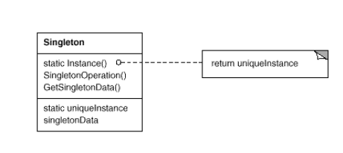
Singleton
Participants:
Singleton-defines an Instance operation that lets clients access its unique instance. Instance is a class operation .It may be responsible for creating its own unique instance. (ex: Singleton)
Structure:

Slide 28
Singleton
Lazy instance: Singleton make use of lazy initiation of the class. It means that its creation is deferred until it is first used. It helps to improve performance, avoid wasteful computation and reduce program memory requirement.
if(singleInstance == null){
singleInstance = new Singleton(); // Lazy initialization
}
Read more: https://stackoverflow.com/questions/978759/what-is-lazy-initialization-and-why-is-it-useful

Slide 29
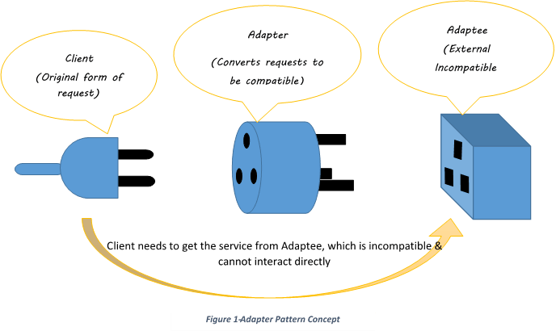
Adapter Pattern
In the real world...
we are very familiar with adapters and what they do

Slide 30
What about object oriented adapters?
Intent: Convert the interface of a class into another interface clients expect. Adapter lets classes work together that couldn't otherwise because of incompatible interfaces. Classified as: A Structural Pattern (Structural patterns are concerned with how classes and objects are composed to form larger structures.) Also Known As: Wrapper

Slide 31
Adapter Pattern
Adapter pattern can be solved in one of two ways:
Class Adapter: its Inheritance based solution
Object Adapter: its Object creation based solution

Slide 32
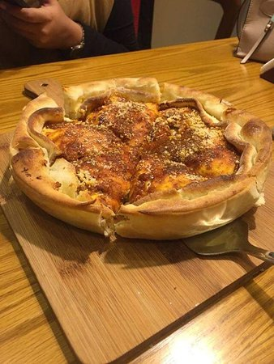
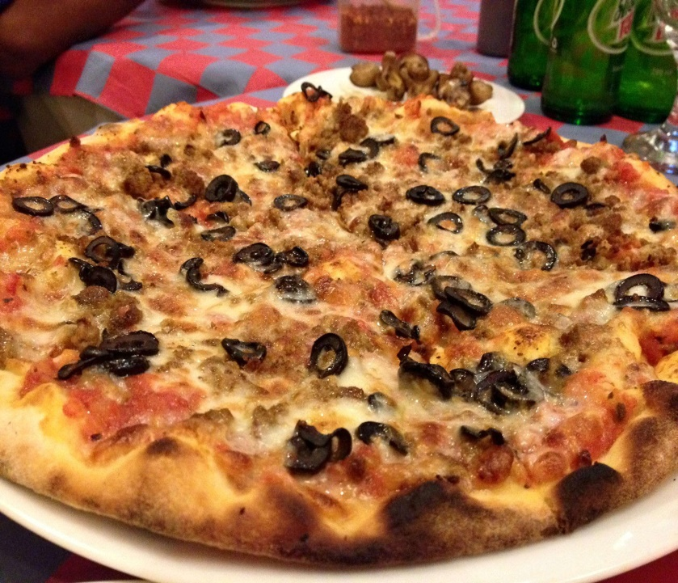
Class Adapter
Scenario: I have a pizza making store that creates different pizzas based on the choices of people of different locations. For example – people of Dhaka like DhakaStylePizza, people of Sylhet like SylhetStylePizza.

Slide 33
Class Adapter
Scenario: I have a pizza making store that creates different pizzas based on the choices of people of different locations. For example – people of Dhaka like DhakaStylePizza, people of Sylhet like SylhetStylePizza.
Solution: To meet the scenario, we can declare a Pizza interface and different location people can make their own style pizza by implementing the same interface.

Slide 34
Class Adapter
Public Interface Pizza{
abstract void toppings();
abstract void bun();
}
Public class DhakaStylePizza implements Pizza{
public void toppings(){
print(“Dhaka cheese toppings”);
}
public void bun(){
print(“Dhaka bread bun”);
}
}
Python Example
https://refactoring.guru/design-patterns/adapter/python/example

Slide 35
Class Adapter
Now we want to support ChittagongStylePizza.
The customer of Chittagong are rigid. They want to use the authentic existing class, ChittagongPizza
But we can not call it directly, as it's not name same as our Pizza interface.
public class ChittagongPizza{
public void sausage(){
print(“Ctg pizza”);
}
public void bread(){
print(“Ctg bread”);
}
}
Public Interface Pizza{
abstract void toppings();
abstract void bun();
}

Slide 36
Class Adapter
We want to adapt the existing ChittagongPizza, so it’s a Adaptee.
To do so, introduce a Class Adapater, ChittagongClassAdapter
Public class ChittagongClassAdapter extends ChittagongPizza implements Pizza{
public void toppings(){
this.sausage();
}
public void bun(){
this.bread();
}
}
public class ChittagongPizza{
public void sausage(){
print(“Ctg pizza”);
}
public void bread(){
print(“Ctg bread”);
}
}

Slide 37
Class Adapter
We want to adapt the existing ChittagongPizza, so it’s a Adaptee.
To do so, introduce a Class Adapater, ChittagongClassAdapter
Customer use the adapter to adapt the adaptee.
Public class ChittagongClassAdapter extends ChittagongPizza implements Pizza{
public void toppings(){
this.sausage();
}
public void bun(){
this.bread();
}
}
public class ChittagongPizza{
public void sausage(){
print(“Ctg pizza”);
}
public void bread(){
print(“Ctg bread”);
}
}
From main method, customer call –
Pizza adaptedPizza = new ChittagongClassAdapter();
adaptedPizza.toppings();
adaptedPizza.bun();

Slide 38
Adapter Pattern
Participants:
Target: defines the domain-specific interface that Client uses. (ex: Pizza)
Client: collaborates with objects conforming to the Target interface.
Adaptee: defines an existing interface that needs adapting (ex: ChittagongPizza)
Adapter: adapts the interface of Adaptee to the Target interface. (ex: ChittagongClassAdapter)

Slide 39
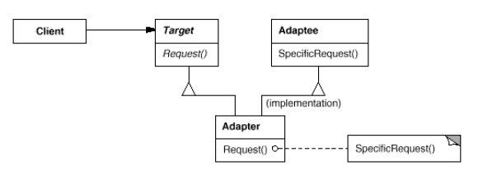
Adapter Pattern
Structure:

Slide 40
Object Adapter
We have the existing adpatee.
Now, create a object adapter for adapting the same ChittagongPizza existing class.
public class ChittagongObjectAdapter implements Pizza{
private ChittagongPizza ctgPizza;
public ChittagongObjectAdapter(){
ctgPizza = new ChittagongPizza();
}
public void toppings(){
ctgPizza.sausage();
}
public void bun(){
ctgPizza.bread();
}
}
public class ChittagongPizza{
public void sausage(){
print(“Ctg pizza”);
}
public void bread(){
print(“Ctg bread”);
}
}

Slide 41
Pros and Cons
Class Adapter: in this case, as it extends the adaptee, it can override the adaptee’s methods. But, It can not use the adaptee’s subclasses.
Object Adapter: As we use object, a parent class object can store subclass object. So, It can adapt the subclasses as well. However, it can not override any behaviour of adaptee.
Check the colab file to get the python examples - Design Patterns Example.ipynb
Read more:
https://refactoring.guru/design-patterns/adapter
https://medium.com/@akshatsharma0610/adapter-design-pattern-in-java-fa20d6df25b8

